Slide 1
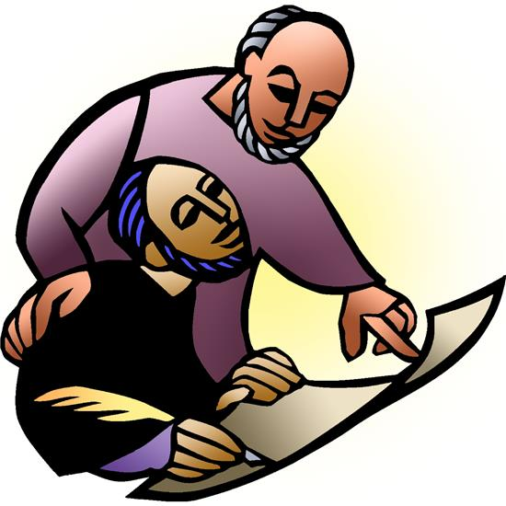
Resurrection Lutheran Church
The Reverend
Karen Perkins, Pastor
People of Resurrection, Ministers of God

Slide 2
Introduction to the day
As we are invited today to consider what it means to be managers (rather than owners) of all that we have, it is crucial to recognize that we are bought with a price. “Christ Jesus, himself human, . . . gave himself a ransom for all.” Apart from the generosity of God we have nothing—we are nothing. By God’s gracious favor we have everything we need.

Slide 3
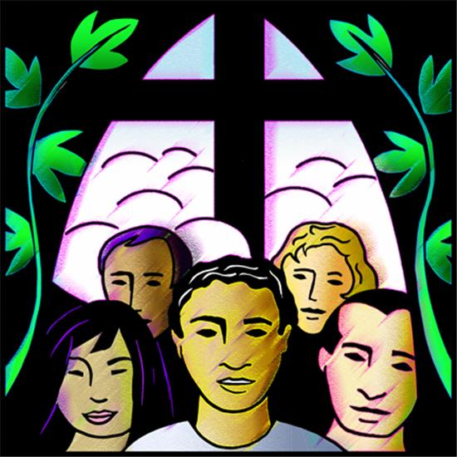
WELCOME and Announcements
Prelude
GATHERING
The Holy Spirit calls us together as the people of God.

Slide 4
Confession and Forgiveness
Blessed be the holy Trinity, ☩ one God,
who is eager to forgive
and who loves us beyond our days.
Amen.

Slide 5
God of mercy and forgiveness,
we confess that sin still has a hold on us.
We have harmed your good creation.
We have failed to do justice,
love kindness,
and walk humbly with you.
Turn us in a new direction.
Show us the path that leads to life.
Be our refuge and strength on the journey,
through Jesus Christ, our redeemer and friend.
Amen.

Slide 6
Beloved of God:
your sins are forgiven ☩ and you are made whole.
God points the way to new life in Christ,
who meets us on the road.
Journey now in God’s abiding love
through the power of the Holy Spirit.
Amen.

Slide 7
Gathering song:
Take My Life, That I May Be

Slide 14
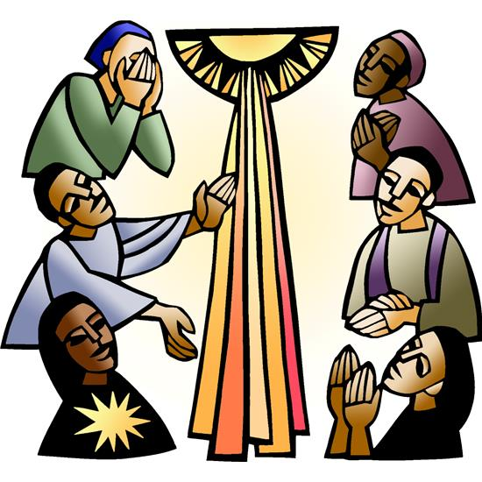
GREETING
The grace of our Lord Jesus Christ,
the love of God,
and the communion of the Holy Spirit
be with you all.
And also with you.
Kyrie (Ghana)

Slide 18
Hymn of Praise (Great Britain)

Slide 30
Prayer of the Day
The Lord be with you.
And also with you.
Let us pray.
Lord God, you call us to work in your vineyard and leave no one standing idle. Set us to our tasks in the work of your kingdom, and help us to order our lives by your wisdom; through your Son, Jesus Christ our Lord.
Amen.

Slide 31
WORD
God speaks to us in scripture reading, preaching, and song.

Slide 32
First Reading: Amos 8:4-7
Amos was called by God to prophesy in the Northern Kingdom of Israel. Peace and prosperity in Israel led to corrupt business practices and oppression of the poor. The prophet declares that God will not tolerate such a situation.
A reading from Amos.

Slide 33
⁴Hear this, you that trample on the needy,
and bring to ruin the poor of the land,
⁵saying, “When will the new moon be over
so that we may sell grain;
and the sabbath,
so that we may offer wheat for sale?
We will make the ephah small and the shekel great,
and practice deceit with false balances,

Slide 34
⁶buying the poor for silver
and the needy for a pair of sandals,
and selling the sweepings of the wheat.”
⁷The Lord has sworn by the pride of Jacob:
Surely I will never forget any of their deeds.
The word of the Lord.
Thanks be to God.

Slide 35
Psalm: Psalm 113
The Lord lifts up the poor from the ashes. (Ps. 113:6)
¹Hallelujah! Give praise, you servants | of the Lord;
praise the name of the Lord.
²Let the name of the Lord be blessed,
from this time forth forevermore.
³From the rising of the sun to its going down
let the name of the Lord be praised.
⁴The Lord is high above all nations,
and his glory above the heavens. R

Slide 36
⁵Who is like the Lord our God,
who sits enthroned on high,
but stoops to behold the heavens and the earth?
⁶He takes up the weak out of the dust
and lifts up the poor from the ashes.
⁷He sets them | with the princes,
with the princes of his people.
⁸He makes the woman of a childless house
to be a joyful mother of children. R

Slide 37
Second Reading: 1 Timothy 2:1-7
The pastoral epistles offer insight into how early Christians understood many practical matters, such as church administration and worship. The church’s focused prayer for others is an expression of the single-minded passion God has toward us in Jesus.
A reading from First Timothy.

Slide 38
¹First of all, then, I urge that supplications, prayers, intercessions, and thanksgivings be made for everyone, ²for kings and all who are in high positions, so that we may lead a quiet and peaceable life in all godliness and dignity. ³This is right and is acceptable in the sight of God our Savior, ⁴who desires everyone to be saved and to come to the knowledge of the truth. ⁵For

Slide 39
there is one God;
there is also one mediator
between God and humankind,
Christ Jesus, himself human,
⁶who gave himself a ransom for all
6—this was attested at the right time.⁷For this I was appointed a herald and an apostle (I am telling the truth, I am not lying), a teacher of the Gentiles in faith and truth.
The word of the Lord.
Thanks be to God.

Slide 40
Children’s Time
Amanda Beebe-Bay

Slide 41
GOSPEL ACCLAMATION
(South Africa)

Slide 43
Gospel: Luke 16:1-13
Jesus tells the curious story of a dishonest manager who cheats his employer and then is commended by him for having acted so shrewdly. Jesus wonders why his own followers are less creative and diligent in their stewardship given that they are managers of a far more valuable household.
The Holy Gospel according to Luke, the 16th chapter.
Glory to you, O Lord.

Slide 44
¹Then Jesus said to the disciples, “There was a rich man who had a manager, and charges were brought to him that this man was squandering his property. ²So he summoned him and said to him, ‘What is this that I hear about you? Give me an accounting of your management, because you cannot be my manager any longer.’ ³Then the manager said to himself, ‘What will I do, now that my master is taking the position away from me? I am not strong enough to dig, and I am ashamed to beg.

Slide 45
⁴I have decided what to do so that, when I am dismissed as manager, people may welcome me into their homes.’ ⁵So, summoning his master’s debtors one by one, he asked the first, ‘How much do you owe my master?’ ⁶He answered, ‘A hundred jugs of olive oil.’ He said to him, ‘Take your bill, sit down quickly, and make it fifty.’ ⁷Then he asked another, ‘And how much do you owe?’ He replied, ‘A hundred containers of wheat.’ He said to him, ‘Take your bill and make it eighty.’

Slide 46
⁸And his master commended the dishonest manager because he had acted shrewdly; for the children of this age are more shrewd in dealing with their own generation than are the children of light. ⁹And I tell you, make friends for yourselves by means of dishonest wealth so that when it is gone, they may welcome you into the eternal homes.
¹⁰“Whoever is faithful in a very little is faithful also in much; and whoever is dishonest in a very little is dishonest also in much.

Slide 47
¹¹If then you have not been faithful with the dishonest wealth, who will entrust to you the true riches? ¹²And if you have not been faithful with what belongs to another, who will give you what is your own? ¹³No slave can serve two masters; for a slave will either hate the one and love the other, or be devoted to the one and despise the other. You cannot serve God and wealth.”
The gospel of the Lord.
Praise to you, O Christ.

Slide 48
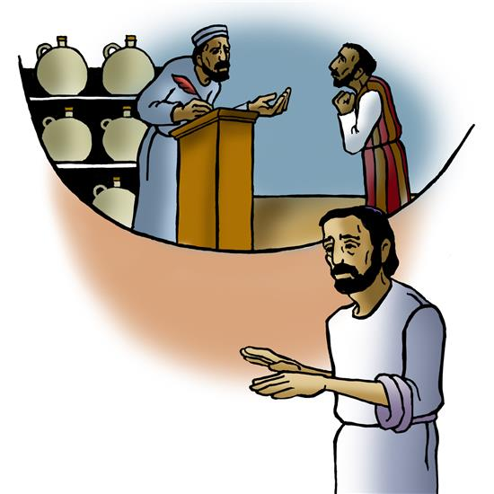
Message Randy Sutak
Hymn of the Day:
Son of God, Eternal Savior

Slide 57
Apostles’ Creed
I believe in God, the Father almighty,
creator of heaven and earth.

Slide 58
I believe in Jesus Christ, God’s only Son, our Lord,
Who was conceived by the power of the Holy Spirit,
and born of the virgin Mary,
He suffered under Pontius Pilate,
was crucified, died, and was buried;
He descended into hell.
On the third day he rose again;
He ascended into heaven,
and is seated at the right hand of the Father,
He will come again to judge the living and the dead.

Slide 59
I believe in the Holy Spirit,
the holy catholic church,
the communion of saints,
the forgiveness of sins,
the resurrection of the body,
and the life everlasting. Amen.

Slide 60
Prayer Refrain:
Abba, Abba, Hear Us (Korea)

Slide 61
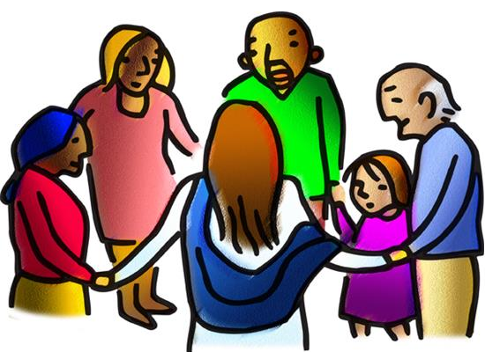
Prayers of Intercession
As scattered grains of wheat are gathered together into one bread, so let us gather our prayers for the church, those in need, and all of God’s good creation.

Slide 62
God our Savior, you keep your church in faith and truth. Accompany those preparing for baptism or affirmation of baptism. Enlighten preachers, teachers, seminarians, and all those who share your good news with the world. God of grace,
hear our prayer.

Slide 63
Divine teacher, you instruct your children to be responsible stewards of your creation. Show us how best to care for the earth and its resources, and guide those who work to develop sustainable practices. God of grace,
hear our prayer.

Slide 64
Ruler of the nations, you direct those in authority. Give leaders wisdom and compassion so that all may live in peace. Inspire public servants to follow the example of courageous leaders, especially Dag Hammarskjöld, and safeguard the dignity of each person. God of grace,
hear our prayer.

Slide 65
Helper of the needy, you lift up those who are oppressed. Breathe justice into economic and social systems that perpetuate poverty and hunger. Sustain food ministries, clothing banks, and emergency shelters, especially the Juneau Cold Weather Emergency Shelter and its patrons. God of grace,
hear our prayer.

Slide 66
Sustainer and giver of life, you bless this congregation with abundance. Instruct us in the proper and faithful use of wealth and resources, that we share generously. God of grace,
hear our prayer.

Slide 67
Wisdom of ages, guide Presiding Bishop Elizabeth Eaton, Alaska Synod Bishop Shelly Wickstrom, Bishop Tessa Moon Leiseth of our sister synod, and Pastor Karen Perkins. Bless our neighbors in the Alaska Southeast Cluster, and Our Savior’s Lutheran Church, Nome. God of grace,
hear our prayer.
For what else do the people of God pray?

Slide 68
God of glory, you gather your saints around your throne. Keep us thankful for the witness of those who have gone before us, and bring us with them to the heavenly feast that has no end. God of grace,
hear our prayer.
Gathered together in the sweet communion of the Holy Spirit, gracious God, we offer these and all our prayers to you; through Jesus Christ, our Savior.
Amen.

Slide 69
Prayer Refrain:
Abba, Abba, Hear Us (Korea)

Slide 70
SHARING THE Peace
The peace of the Lord be with you always.
And also with you.
The congregation may greet one another
in the name of the Lord.
Peace be with you.
Peace be with you.

Slide 71
MEAL
God feeds us with the presence of Jesus Christ.
OFFERING

Slide 72
Presentation of the Gifts (Nicaragua)

Slide 83
Offertory Prayer
Gracious God,
in your great love you richly provide for our needs.
Make of these gifts a banquet of blessing,
and make us ready to share with all in need;
through Jesus Christ, who sets a table for all.
Amen.

Slide 84
Randy Sutak is authorized to preside today
by the synod bishop.
Great Thanksgiving
The Lord be with you.
And also with you.
Lift up your hearts.
We lift them to the Lord.
Let us give thanks to the Lord our God.
It is right to give our thanks and praise.

Slide 85
Preface
It is indeed right and salutary that we should
at all times and in all places
offer thanks and praise to you, O Lord, holy Father,
through Christ our Lord;
who on this day overcame death and the grave,
and by his glorious resurrection
opened to us the way of everlasting life.

Slide 86
And so, with the Church on earth
and the hosts of heaven,
we praise your name
and join their unending hymn:

Slide 87
Sanctus (Austria)

Slide 89
Thanksgiving at the Table
Holy God,
our Maker, Redeemer, and Healer,
in the harmonious world of your creation,
the plants and animals,
the seas and stars
were whole and well in your praise.
When sin had scarred the world,
you sent your Son to heal our ills
and to form us again into one.

Slide 90
In the night in which he was betrayed,
our Lord Jesus took bread, and gave thanks;
broke it, and gave it to his disciples, saying:
Take and eat; this is my body, given for you.
Do this for the remembrance of me.
Again, after supper, he took the cup, gave thanks,
and gave it for all to drink, saying:
This cup is the new covenant in my blood,
shed for you and for all people
for the forgiveness of sin.
Do this for the remembrance of me.

Slide 91
Remembering, therefore,
his acts of healing,
his body given up,
and his victory over death,
we await that day when all the peoples of the earth
will come to the river to enjoy the tree of life.
Send your Spirit upon us and this meal:
as grains scattered on the hillside become one bread,
so let your Church be gathered
from the ends of the earth,
that all may be fed with the Bread of life, your Son.

Slide 92
Through him all glory and honor is yours,
Almighty Father, with the Holy Spirit,
in your holy Church,
both now and forever.
Amen

Slide 93
Lord’s Prayer
Lord, remember us in your kingdom,
and teach us to pray:
Our Father, who art in heaven,
hallowed be thy name,
thy kingdom come, thy will be done,
on earth as it is in heaven.

Slide 94
Give us this day our daily bread;
and forgive us our trespasses,
as we forgive those who trespass against us;
and lead us not into temptation,
but deliver us from evil.
For thine is the kingdom,
and the power, and the glory,
forever and ever.
Amen.

Slide 95
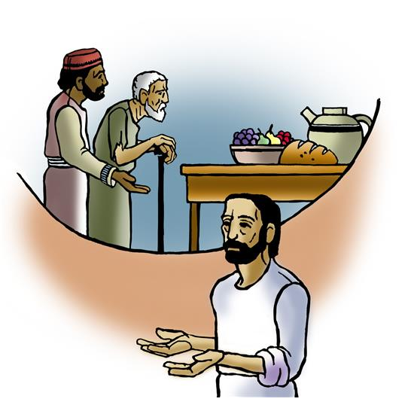
Invitation to Communion
In Christ’s presence there is fullness of joy.
Come to the banquet.

Slide 96
Communion Song (America)

Slide 98
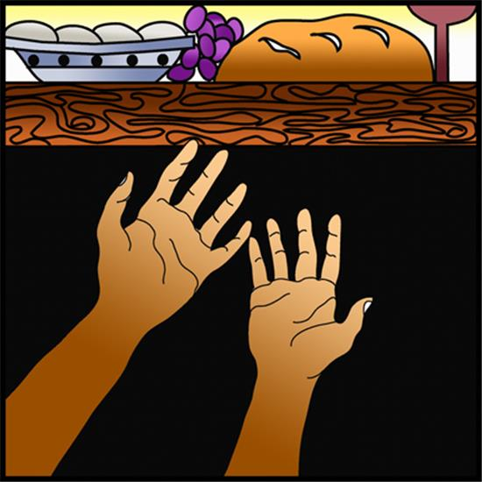
POST COMMUNION BLESSING
The body and blood of our Lord Jesus Christ
strengthen you and keep you in his grace.
Amen.
Post-Communion Canticle (South Africa)

Slide 104
PRAYER AFTER COMMUNION
God of the abundant table,
you have refreshed our hearts in this meal
with bread for the journey.
Give us your grace on the road
that we might serve our neighbors with joy;
for the sake of Jesus Christ, our Lord.
Amen.

Slide 105
SENDING
God blesses us and sends us in mission to the world.
MISSION STATEMENT
Let us announce together,
The mission of Resurrection Lutheran Church is
to promote spiritual growth in Christ
and service to all people.

Slide 106
BLESSING
God, who gives life to all things
and frees us from despair,
bless you with truth and peace.
And may the holy Trinity, ☩ one God,
guide you always in faith, hope, and love.
Amen.

Slide 107
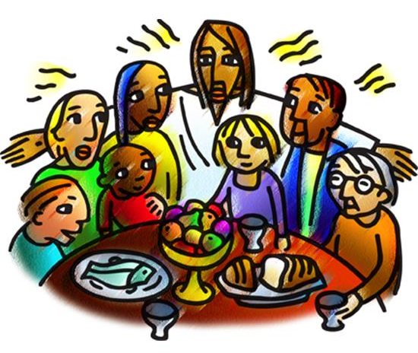
Sending Song:
Rise Up, O Saints of God!

Slide 113
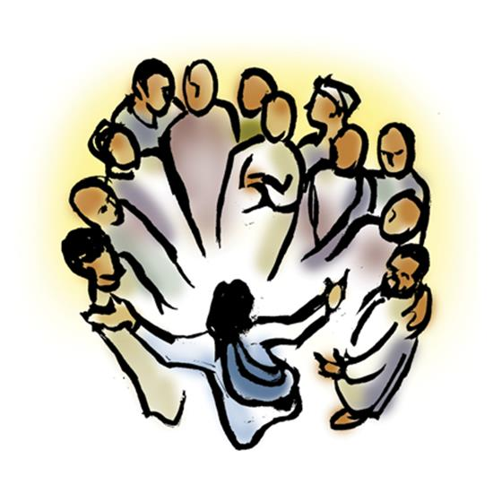
DISMISSAL
Go in peace, with Christ beside you.
Thanks be to God.

Slide 114
Resurrection Lutheran Church
The Reverend
Karen Perkins, Pastor
People of Resurrection, Ministers of God

