Slide 1
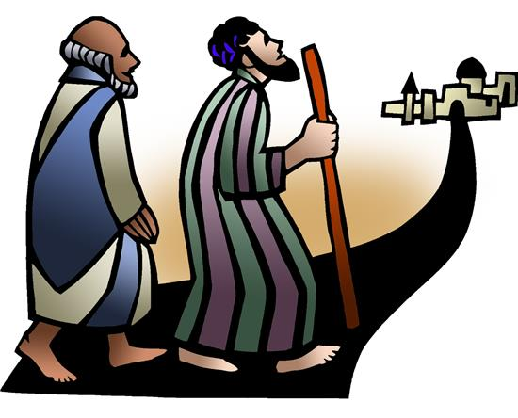
Resurrection Lutheran Church
The Reverend
Karen Perkins, Pastor
People of Resurrection, Ministers of God

Slide 2
Introduction to the day
God is the source of our nourishment. Jesus’ invitation to “take and eat . . . take and drink” is a repeated one. In holy communion, in the word read and proclaimed, in the assembly of the people of God, the dominion of God has come near. Rejoice! Your name is written in heaven.

Slide 3
WELCOME and Announcements
Prelude
GATHERING
The Holy Spirit calls us together as the people of God.

Slide 4
Confession and Forgiveness
Blessed be the holy Trinity,☩ one God,
whose steadfast love endures forever.
Amen.
Let us confess our sin in the presence of God
and of one another.

Slide 5
Merciful God,
we confess that we have not followed your path
but have chosen our own way.
Instead of putting others before ourselves,
we long to take the best seats at the table.
When met by those in need,
we have too often passed by on the other side.
Set us again on the path of life.
Save us from ourselves
and free us to love our neighbors.
Amen.

Slide 6
Hear the good news!
God does not deal with us according to our sins
but delights in granting pardon and mercy.
In the name of ☩ Jesus Christ, your sins are forgiven.
You are free to love as God loves.
Amen.

Slide 7
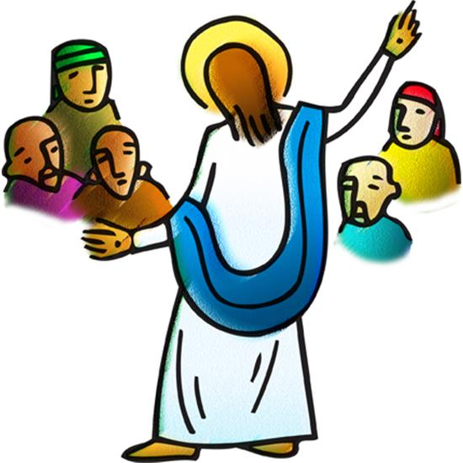
Gathering Hymn:
We All Are One in Mission

Slide 14
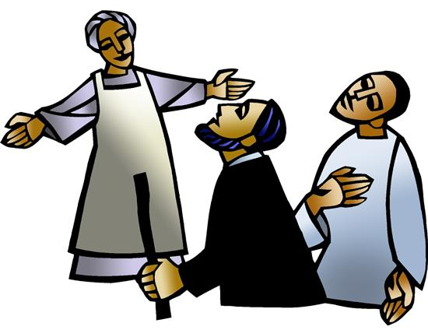
GREETING
The grace of our Lord Jesus Christ, the love of God,
and the communion of the Holy Spirit be with you all.
And also with you.

Slide 15
KYRIE

Slide 19
HYMN OF PRAISE

Slide 24
Prayer of the Day
Let us pray.
O God, the Father of our Lord Jesus, you are the city that shelters us, the mother who comforts us. With your Spirit accompany us on our life’s journey, that we may spread your peace in all the world, through your Son, Jesus Christ, our Savior and Lord.
Amen.

Slide 25
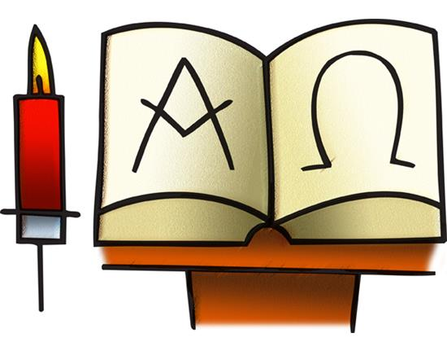
WORD
God speaks to us in scripture reading, preaching, and song.

Slide 26
First Reading: Isaiah 66:10-14
Those who returned from the exile found that the hopes for the glorious restoration of Judah were not completely fulfilled. For these disappointed people, the prophet envisions salvation in the image of a nursing woman. Mother Jerusalem and a mothering God remind the community how they are sustained and supported.
A reading from Isaiah.

Slide 27
¹⁰Rejoice with Jerusalem, and be glad for her,
all you who love her;
rejoice with her in joy,
all you who mourn over her—
¹¹that you may nurse and be satisfied
from her consoling breast;
that you may drink deeply with delight
from her glorious bosom.

Slide 28
¹²For thus says the Lord:
I will extend prosperity to her like a river,
and the wealth of the nations
like an overflowing stream;
and you shall nurse and be carried on her arm,
and dandled on her knees.
¹³As a mother comforts her child,
so I will comfort you;
you shall be comforted in Jerusalem.

Slide 29
¹⁴You shall see, and your heart shall rejoice;
your bodies shall flourish like the grass;
and it shall be known that the hand of the Lord
is with his servants,
and his indignation is against his enemies.
The word of the Lord.
Thanks be to God.

Slide 30
Psalm: Psalm 66:1-9
All the earth bows down before you and sings out your name. (Ps. 66:4)
¹Be joyful in God, all you lands;
be joyful, all the earth.
²Sing the glory of God’s name;
sing the glory of God’s praise.
³Say to God, “How awesome are your deeds!
Because of your great strength
your enemies cringe before you.
⁴All the earth bows down before you,
sings to you, sings out your name.” R

Slide 31
⁵Come now and see the works of God,
how awesome are God’s deeds toward all people.
⁶God turned the sea into dry land,
so that they went through the water on foot,
and there we rejoiced in God.
⁷Ruling forever in might,
God keeps watch over the nations;
let no rebels exalt themselves.
⁸Bless our God, you peoples;
let the sound of praise be heard.
⁹Our God has kept us among the living
and has not allowed our feet to slip. R

Slide 32
Second Reading:
Galatians 6:[1-6] 7-16
In the close of his letter to the Galatians, Paul encourages them to live as people made right with God through faith in Jesus Christ. Here Paul offers practical advice about how believers exercise common concern for one other in “the family of faith.”
A reading from Galatians.

Slide 33
[¹My friends, if anyone is detected in a transgression, you who have received the Spirit should restore such a one in a spirit of gentleness. Take care that you yourselves are not tempted. ²Bear one another’s burdens, and in this way you will fulfill the law of Christ. ³For if those who are nothing think they are something, they deceive themselves. ⁴All must test their own work; then that work, rather than their neighbor’s work, will become a cause for pride. ⁵For all must carry their own loads.

Slide 34
⁶Those who are taught the word must share in all good things with their teacher.]
⁷Do not be deceived; God is not mocked, for you reap whatever you sow. ⁸If you sow to your own flesh, you will reap corruption from the flesh; but if you sow to the Spirit, you will reap eternal life from the Spirit. ⁹So let us not grow weary in doing what is right, for we will reap at harvest time, if we do not give up. ¹⁰So then, whenever we have an opportunity, let us work for the good of all, and especially for those of the family of faith.

Slide 35
¹¹See what large letters I make when I am writing in my own hand! ¹²It is those who want to make a good showing in the flesh that try to compel you to be circumcised—only that they may not be persecuted for the cross of Christ. ¹³Even the circumcised do not themselves obey the law, but they want you to be circumcised so that they may boast about your flesh.

Slide 36
¹⁴May I never boast of anything except the cross of our Lord Jesus Christ, by which the world has been crucified to me, and I to the world. ¹⁵For neither circumcision nor uncircumcision is anything; but a new creation is everything! ¹⁶As for those who will follow this rule—peace be upon them, and mercy, and upon the Israel of God.
The word of the Lord.
Thanks be to God.

Slide 37
Children’s Time
Amanda Beebe-Bay

Slide 38
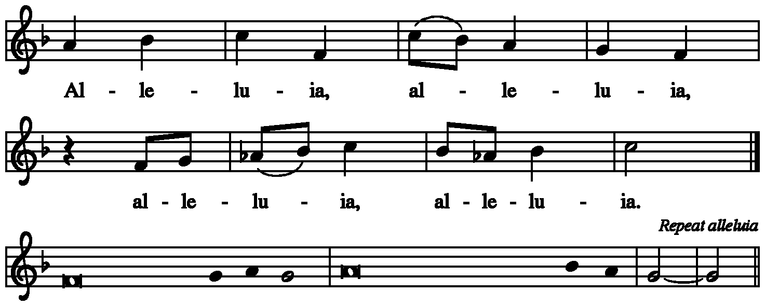
GOSPEL ACCLAMATION

Slide 39
Gospel: Luke 10:1-11, 16-20
Jesus commissions harvesters and laborers to go where he would go and do what he would do. Risking hardship and danger in exchange for the experience of great joy, they offer peace and healing as signs that the reign of God is near.
The holy gospel according to Luke.
Glory to you, O Lord.

Slide 40
¹After this the Lord appointed seventy others and sent them on ahead of him in pairs to every town and place where he himself intended to go. ²He said to them, “The harvest is plentiful, but the laborers are few; therefore ask the Lord of the harvest to send out laborers into his harvest. ³Go on your way. See, I am sending you out like lambs into the midst of wolves. ⁴Carry no purse, no bag, no sandals; and greet no one on the road. ⁵Whatever house you enter, first say, ‘Peace to this house!’

Slide 41
⁶And if anyone is there who shares in peace, your peace will rest on that person; but if not, it will return to you. ⁷Remain in the same house, eating and drinking whatever they provide, for the laborer deserves to be paid. Do not move about from house to house. ⁸Whenever you enter a town and its people welcome you, eat what is set before you; ⁹cure the sick who are there, and say to them, ‘The kingdom of God has come near to you.’

Slide 42
¹⁰But whenever you enter a town and they do not welcome you, go out into its streets and say, ¹¹‘Even the dust of your town that clings to our feet, we wipe off in protest against you. Yet know this: the kingdom of God has come near.’ ”
¹⁶“Whoever listens to you listens to me, and whoever rejects you rejects me, and whoever rejects me rejects the one who sent me.”

Slide 43
¹⁷The seventy returned with joy, saying, “Lord, in your name even the demons submit to us!” ¹⁸He said to them, “I watched Satan fall from heaven like a flash of lightning. ¹⁹See, I have given you authority to tread on snakes and scorpions, and over all the power of the enemy; and nothing will hurt you. ²⁰Nevertheless, do not rejoice at this, that the spirits submit to you, but rejoice that your names are written in heaven.”
The gospel of the Lord.
Praise to you, O Christ.

Slide 44
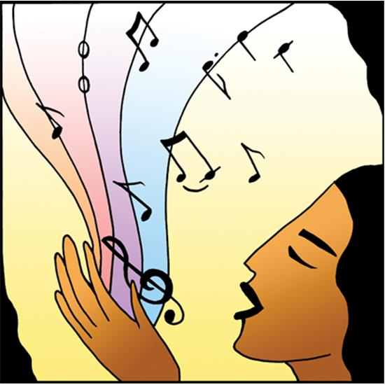
sermon Rev. Lisa Smith-Fiegel
Hymn of the Day:
Lord Jesus, You Shall Be My Song

Slide 53
Apostles’ Creed
Let us confess together,
I believe in God, the Father almighty,
creator of heaven and earth.
I believe in Jesus Christ, God’s only Son, our Lord,
who was conceived by the Holy Spirit,
born of the virgin Mary,
suffered under Pontius Pilate,
was crucified, died, and was buried;
he descended to the dead.*

Slide 54
On the third day he rose again;
he ascended into heaven,
he is seated at the right hand of the Father,
and he will come to judge the living
and the dead.
I believe in the Holy Spirit,
the holy catholic church,
the communion of saints,
the forgiveness of sins,
the resurrection of the body,
and the life everlasting. Amen.

Slide 55
PRAYER REFRAIN:
O Living Breath of God

Slide 56
Prayers of Intercession
United in Christ and guided by the Spirit, we pray for the church, the creation, and all in need.
A brief silence.

Slide 57
Lord of the harvest, you send your church into the world to proclaim Christ’s new creation to all. Renew the church as it carries out your mission of peace and healing. We pray for missionaries who accompany your people. God of grace,
hear our prayer.

Slide 58
Your creation abounds with flowing waters and diverse creatures. Guide the work of climate scientists as they develop and advocate ways to restore earth’s natural balance. Motivate humankind to adopt lifestyles that protect and sustain the earth. Be with those suffering climate related disasters, especially people of Sydney, Australia. God of grace,
hear our prayer.

Slide 59
You guard the nations; let no leaders exalt themselves, but lift up the most vulnerable and work for the good of all. Send your Spirit to eradicate classism, racism, sexism and inequity; violence and war; poverty and hunger. God of grace,
hear our prayer.

Slide 60
You desire abundant life for all. As we celebrate Independence Day, instill in us gratitude, generosity, and persistence in working toward freedom for all people, especially those in Myanmar, Sudan and Ukraine. God of grace,
hear our prayer.

Slide 61
Mothering God, you care for all people in need. Nourish those who are hungry. Restore employment to those who have lost work. Heal those who are sick, and comfort all who are dying or grieving. God of grace,
hear our prayer.

Slide 62
God of wisdom, guide the work of those in public ministry, especially Presiding Bishop Elizabeth Eaton, Alaska Synod Bishop Shelly Wickstrom, Bishop Tessa Moon Leiseth of our sister synod, and Pastor Karen Perkins, the Alaska Southeast Cluster, Resurrection Lutheran, Seward and local ministry partners. God, in your mercy,
hear our prayer.

Slide 63
For what else do the people of God pray?
We remember the saints who proclaimed your reign on earth and now rest in you especially Thomas the Apostle, whom we remember today. Make us faithful in our witness to Christ’s new creation. God of grace,
hear our prayer.

Slide 64
God of every time and place, in Jesus’ name and filled with your Holy Spirit, we entrust these spoken prayers and those in our hearts into your holy keeping.
Amen.

Slide 65
Repeat PRAYER REFRAIN:

Slide 66
SHARING OF THE PEACE
The peace of the Lord be with you always.
And also with you.
We greet each other with a gesture of peace. We are incorporating social-distancing recommendations at this time, so a nod, elbow-bump, or fist bump are most appropriate. This greeting is a sign of the risen Christ who unites us and calls us to recognize the peace of God in one another.

Slide 67
MEAL
God feeds us with the presence of Jesus Christ.
OFFERING

Slide 68
Presentation of the Gifts

Slide 71
OFFERING PRAYER
God of abundance:
you have set before us a plentiful harvest.
As we feast on your goodness,
strengthen us to labor in your field,
and equip us to bear fruit for the good of all,
in the name of Jesus.
Amen.

Slide 72
Dialogue
The Lord be with you.
And also with you.
Lift up your hearts.
We lift them to the Lord.
Let us give thanks to the Lord our God.
It is right to give our thanks and praise.

Slide 73
Preface
It is indeed right, our duty and our joy,
that we should at all times and in all places
give thanks and praise to you,
almighty and merciful God.
through our Savior Jesus Christ;
who on this day overcame death and the grave,
and by his glorious resurrection opened to us
the way of everlasting life.

Slide 74
And so, with all the choirs of angels,
with the church on earth and the hosts of heaven,
we praise your name and join their unending hymn:

Slide 75
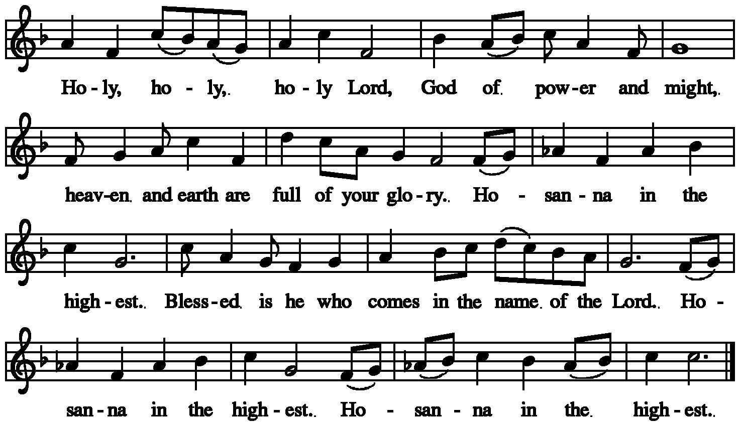
HOLY, HOLY, HOLY

Slide 77
Thanksgiving at the table
Holy God,
our Maker, Redeemer, and Healer,
in the harmonious world of your creation,
the plants and animals,
the seas and stars
were whole and well in your praise.

Slide 78
When sin had scarred the world,
you sent your Son to heal our ills
and to form us again into one.
In the night in which he was betrayed,
our Lord Jesus took bread, and gave thanks;
broke it, and gave it to his disciples, saying:
Take and eat; this is my body, given for you.
Do this for the remembrance of me.

Slide 79
Again, after supper, he took the cup, gave thanks,
and gave it for all to drink, saying:
This cup is the new covenant in my blood,
shed for you and for all people
for the forgiveness of sin.
Do this for the remembrance of me.

Slide 80
Remembering, therefore,
his acts of healing,
his body given up,
and his victory over death,
we await that day when all the peoples of the earth
will come to the river to enjoy the tree of life.

Slide 81
Send your Spirit upon us and this meal:
as grains scattered on the hillside become one bread,
so let your Church be gathered
from the ends of the earth,
that all may be fed with the Bread of life, your Son.
Through him all glory and honor is yours,
Almighty Father, with the Holy Spirit,
in your holy Church,
both now and forever.
Amen

Slide 82
Lord’s Prayer
Gathered into one by the Holy Spirit, let us pray as Jesus taught us.
Our Father, who art in heaven,
hallowed be thy name,
thy kingdom come,
thy will be done,
on earth as it is in heaven.

Slide 83
Give us this day our daily bread;
and forgive us our trespasses,
as we forgive those
who trespass against us;
and lead us not into temptation,
but deliver us from evil.
For thine is the kingdom,
and the power, and the glory,
forever and ever. Amen.

Slide 84
Invitation to Communion
In Christ’s presence there is fullness of joy.
Come to the banquet.

Slide 85
Communion Distribution
All are welcome to the communion table! God is the host and God's love extends to all people. During this period of social distancing due to COVID-19, not all in our community are ready to be present at Resurrection. Nevertheless, there are ways for you to participate! We celebrate this holy meal as the community of peace, love and mercy.
We have resources on our website to help you celebrate Holy Communion at home, either along with a live broadcast or at another time. Pastor Karen can bring the Eucharist to you at home. Please contact the office or Pastor Karen to make arrangements.
We would be happy to light a candle in thankfulness, of concern, or in memory of a person at your request.

Slide 86
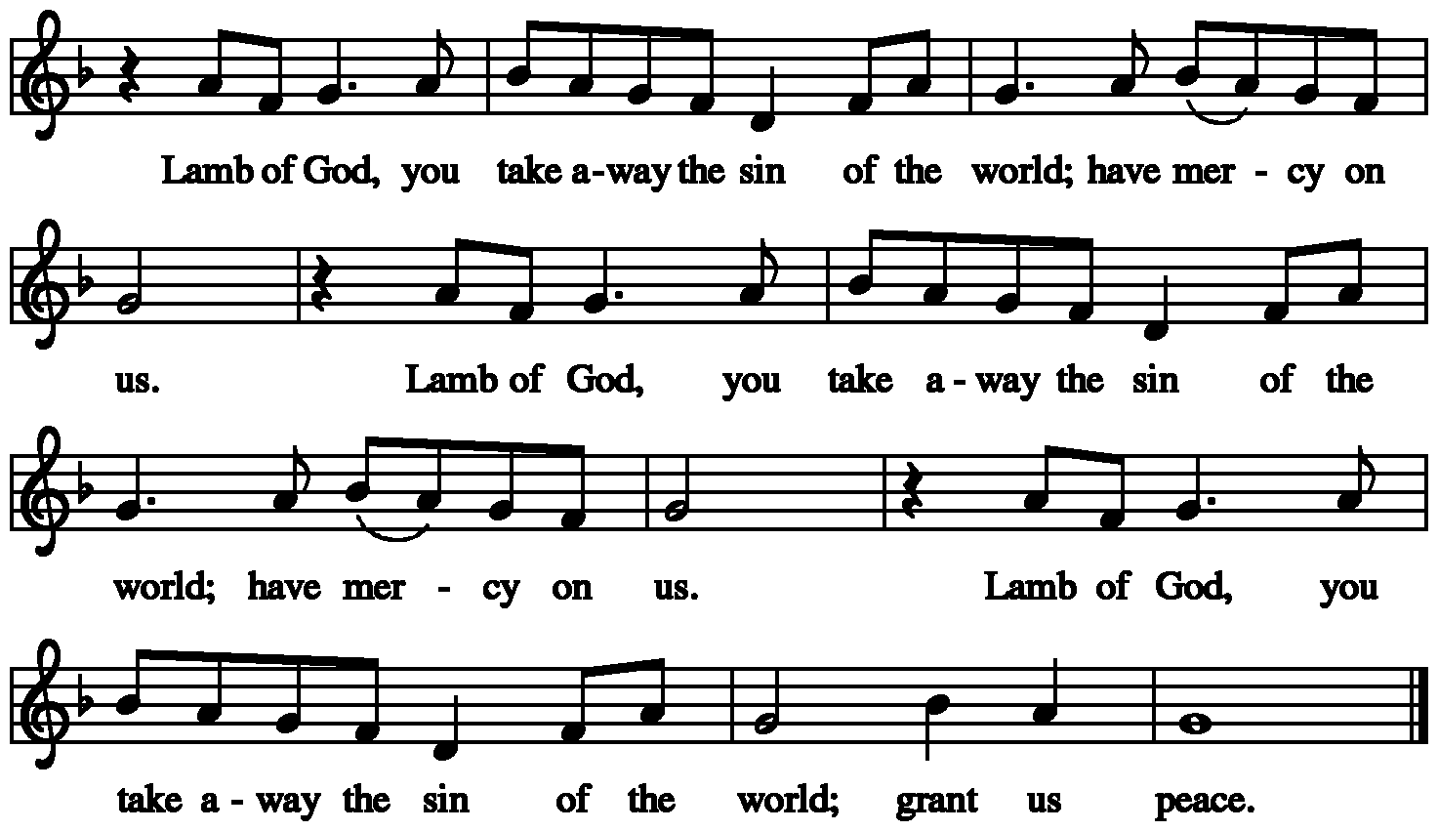
Communion Song

Slide 88
Communion
The body of Christ, given for you.
Amen.
The blood of Christ, shed for you.
Amen.

Slide 89
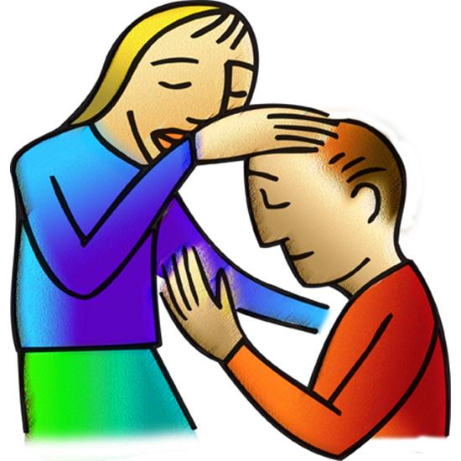
Post Communion Blessing
The body and blood of our Lord Jesus Christ strengthen you and keep you in God’s grace.

Slide 90
SONG AFTER COMMUNION

Slide 92
PRAYER AFTER COMMUNION
Life-giving God,
through this meal you have bandaged our wounds
and fed us with your mercy.
Now send us forth to live for others,
both friend and stranger,
that all may come to know your love.
This we pray in the name of Jesus.
Amen.

Slide 93
SENDING
God blesses us and sends us in mission to the world.
MISSION statement
Let us announce together:
The mission of Resurrection Lutheran Church
is to promote spiritual growth in Christ
and service to all people.

Slide 94
Blessing
The God of peace,
Father, ☩ Son, and Holy Spirit,
bless you, comfort you,
and show you the path of life
this day and always.
Amen.

Slide 95
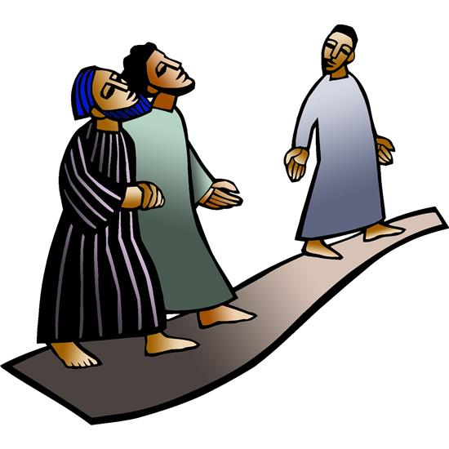
SENDING HYMN:
Go to the World

Slide 104
SENDING
Go in peace. Love your neighbor.
Thanks be to God.

Slide 105
Resurrection Lutheran Church
The Reverend
Karen Perkins, Pastor
People of Resurrection, Ministers of God

